Slide 1
Federal Policy Update
Presented by
The New England Fuel Institute
at the
Southern New England Energy Conference
September 23, 2014

Slide 2

An Effort on Three Fronts
Regional Policies & Outreach
  Michael C. Trunzo, President & CEO
Federal Legislation
  Jim Collura, Vice President for Gov’t Affairs
Federal Regulations
  Mark S. Morgan Esq., Regulatory Counsel

Slide 3
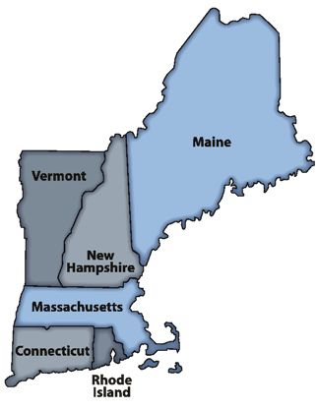
Regional Policy
Michael C. Trunzo, NEFI President & CEO

Slide 4
REGIONAL POLICIES & OUTREACH
LIHEAP Efficiency and Reform
ISO New England Winter Reliability Program
Biodiesel Blending Requirement
Northeast States for Coordinated Air Use Management (NESCAUM)

Slide 5
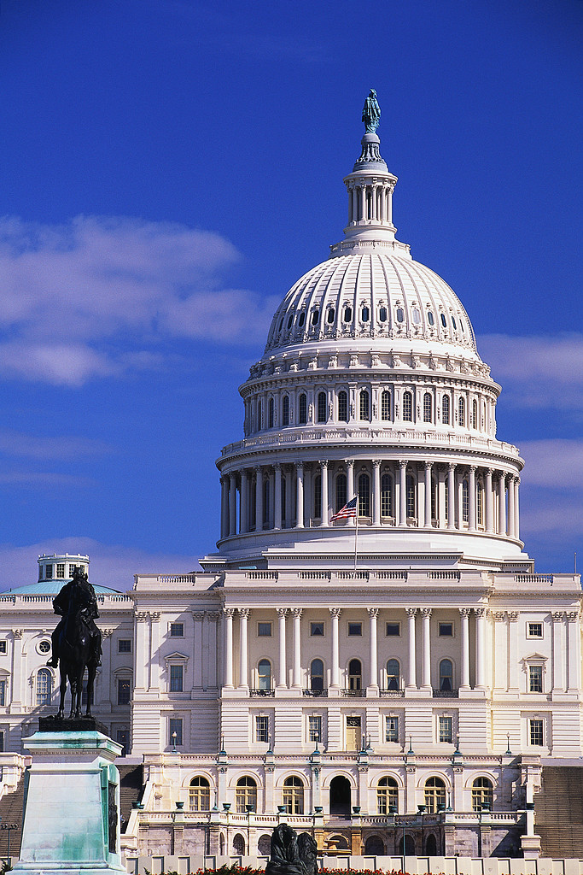
Federal Legislation
Jim Collura, NEFI Vice President for Government Affairs

Slide 6
2014 Mid-term Elections
House & Senate are in Recess
  Will return week of Nov. 10th for “Lame Duck”
  Election Day: November 4, 2014
  Democrats are defending more seats (21-15)
Republicans Control House of Reps.
  Almost certain they will retain majority
Democrats Control the Senate (for now)
  Senate is considered up-for-grabs

Slide 7
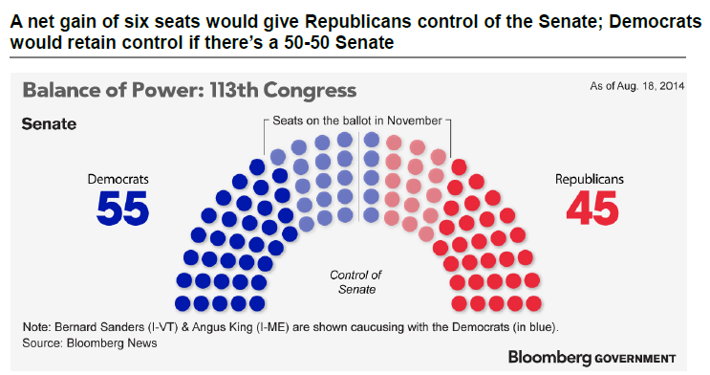

Slide 8
Seats Likely to go Republican
Arkansas Sen. Pryor (D) vs. Cotton (R)
  Republican +5% (9/2-9/4 NBC News/Marist)
Alaska Sen. Begich (D) vs. Sullivan (R)
  Republican +6% (8/18-9/2 CBS News/NYT/YouGov)
South Dakota* Dem & Ind. Vs. Rounds (R)
  Republican +11% (9/3-9/7 Suvey USA)
Louisiana Sen. Landrieu (D) vs. Cassidy (R)
  Republican +13% (9/14-9/16 Fox News)
Montana* Walsh (D) vs. Daines (R)
  Republican +19% (8/18-9/2 CBS News/NYT/YouGov)
West Virginia* Tennant (D) vs. M. Capito (R)
  Republican +23% (8/18-9/2 CBS News/NYT/YouGov)

Slide 9
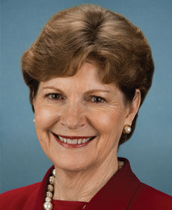
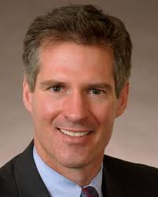
New Hampshire Senate Race
Sen. Jeanne Shaheen (D) vs. Scott Brown (R)
48%
48%
CNN/Opinion research 9/8-9/11

Slide 10
Other Senate Races to Watch
Other Democrat Seats at Risk:
  Iowa (Open) – Braley (D) vs. Ernst (R)
  Colorado – Sen. Udall (D) vs. Gardner (R)
  Michigan (Open) – Peters (D) vs. Land (R)
  North Carolina – Sen. Hagan (D) vs. Tillis (R)
Three Republican Seats at Risk:
  Kansas - Roberts (R) vs. Orman (I) vs. Taylor (D)
  Georgia (Open) – Perdue (R) vs. Nunn (D)
  Kentucky - Sen. McConnell (R) vs. Grimes (D)

Slide 11
“Lame Duck” Agenda
Lame Duck Session (Nov. 10th - Dec. 11th)
Must-pass Legislation:
  Final FY2015 Spending Bill
  “Tax Extenders” – Biodiesel Tax Credit, Home Efficiency Tax Credit, Small Business Credits
Might-pass Legislation:
  Bills requiring studies into Hours-of-Service and Trans. Worker Identification Credential (TWIC)
Propane Supply Legislation Introduced
Control of Senate will affect the Agenda

Slide 12
IF DEMOCRATS WIN SENATE
MORE
OF THE
SAME
(But seriously, if they did something…)
Changes to the Motor Fuels Tax?
CFTC Reauthorization
Energy efficiency legislation
Modest tax reform

Slide 13
IF REPUBLICANS WIN SENATE
Comprehensive Tax Reform
Roll-back Dodd-Frank Trading Reforms
Change Obamacare Employer Mandate
Approve Keystone XL & LNG Exports
Deregulate Nat Gas Pipeline Permitting
“Messaging Legislation” for 2016
  Lift of Restrictions on U.S. Oil & Gas Drilling
  Ban Federal Regulation of Greenhouse Gases
  Require Administration to Seek Congressional Approval for Costly Regulations

Slide 14
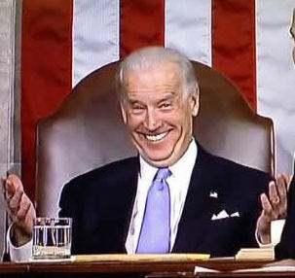
IF THERE IS A TIE
“Uh oh… better call Joe”

Slide 15
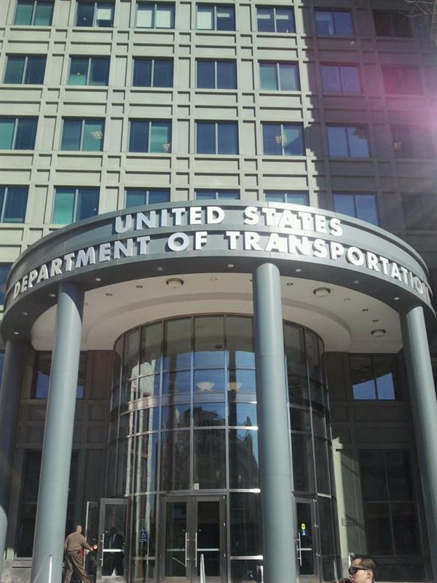
Federal Regulations
Mark S. Morgan Esq., NEFI Regulatory Counsel

Slide 16
FIVE MOST FREQUENTLY CITED FEDERAL REGULATORY
VIOLATIONS

Slide 17
#1. CDL Driver Failure to Wear Seatbelt
Federal Motor Carrier Safety Administration (FMCSA)
40 CFR 392.16 - “A commercial motor vehicle that has a seat belt assembly installed at the driver’s seat shall not be driven unless the driver has properly restrained himself/herself with the seat belt assembly.”
PENALTY - $1,000 first offense. Out of service for third offense plus potential fine up to $75,000 and CDL driver suspended
Roadside Inspection

Slide 18
#2. Shipping Paper Entries Not in Required Sequence
Pipeline and Hazardous Material Safety Administration (PHMSA)
OLD = Fuel Oil #2, 3, NA1993, PGIII
NEW = NA1993, Fuel Oil #2, 3, PGIII
  Required Beginning January 1, 2013
PENALTY - $1,700 per occurrence, likely out of service order, probable on site compliance audit.

Slide 19
#3. Failure to Provide Emergency Response Phone Number on Shipping Paper
U.S. DOT Pipeline and Hazardous Materials Safety Administration
Regulates intrastate and interstate hazardous material transportation.
49 CFR 172.604 -“A person who offers a hazardous material for transportation must provide an emergency response telephone number…..for use in the event of an emergency involving the hazardous material.”
You must provide the number yourself. You cannot piggy-back on emergency numbers used by other companies without authorization.
PENALTY- $2,600 for the first offense, possible out of service order.

Slide 20
#4. Failure to Provide SPCC Secondary Containment for Parked Trucks
U.S. Environmental Protection Agency (EPA)
Secondary Containment for Parked Trucks
OLD: 40 CFR 112.6 - Trucks containing product that are parked overnight containing more than a residue of product must have sized secondary containment.
NEW: 40 CFR 112.6 - Trucks containing product that are parked overnight and containing more than a residue of product must have general secondary containment.

Slide 21
#4. Failure to Provide SPCC Secondary Containment for Parked Trucks (continued)
Sized Secondary Containment – Trucks must be parked within a dyke or berm and catchment system sufficient to contain the capacity of the single largest compartment of the cargo tank vehicle.
General Secondary Containment – Trucks must be equipped with drip pans sufficient to contain the mostly likely leak from the cargo tank vehicle.
  The most likely leak is from a hose or leaky valve (25-50 gallons)
  Definition of most likely leak must be in SPCC plan.
  Absorbents are not enough unless the site is manned 24 hours and a liquid release alarm is sounded.

Slide 22
# 5. IRS DYED FUEL DISPENSER LABELS
Internal Revenue Service (IRS):
The following IRS labels must be posted on dispensers:
“DYED DIESEL FUEL, NONTAXABLE USE ONLY, PENALTY FOR TAXABLE USE”
“DYED KEROSENE, NONTAXABLE USE ONLY, PENALTY FOR TAXABLE USE”.
The following label must be posted on all blocked pumps that sell clear, untaxed kerosene:
"UNDYED UNTAXED KEROSENE, NONTAXABLE USE ONLY".

Slide 23
# 5. IRS DYED FUEL DISPENSER LABELS (Continued)
The labels must be affixed to the dispenser in a conspicuous place within easy sight of the person dispensing the fuel either on the face of the dispenser (on both sides) or on the side of the dispenser just above the nozzle housing.
All dispensers including retail, wholesale, skid tanks.
PENALTY: $10.00 for every gallon of fuel in the tank attached to the dispenser.

Slide 24
Thank you for your support!
Michael C. Trunzo, NEFI President & CEO
michael.trunzo@nefi.com
(617) 923-5011
Jim Collura, Vice President for Gov’t Affairs
jim.collura@nefi.com
(617) 923-5023
Mark S. Morgan, Esq., Regulatory Counsel
mark@nefi.com
(202) 364-6767
www.nefi.com

